Slide 1

Cambodia Academy of Digital Technology
Digital Research and Development Center
Data Science
Presentation
Presented by : Teng Chanto
500,000
250,000
100,000

Slide 2
Data Science Interests
Data Extraction
Data Quality/Report
Data Cleansing
01
Data Engineering
Statistical Data Analysis
Exploratory Data Analysis
Data Visualization
03
Data Analysis and Visualization
Data Science Interests
Affinity Analysis
Clustering/Classification
Regression
04
Data Modeling

Slide 3

Weather Forecasting
Data
ML-DL
Data Analysis
data visualization
Introduction to research and development on approaches to Data science.

Slide 4
Weather Forecasting
Abstract
Weather forecasting has gained researchers from worldwide societies over decades due to its substantial impact on global human life from agriculture , air traffic control to public health and safety.
For Predicting weather forecasting we will use machine learning Algorithms like Linear Regression, Decision tree. Keywords: Weather forecasting Flood control Secure , environment Learning models , Time series analysis, Predictive Analytics, Weather Forecasting.

Slide 5
Weather Forecasting
Machine Learning Technique is most robust technique for predicting weather forecasting .
In past days we had to give instructions to System and then it gave result. but now we have machine learning algorithm so we can directly give inputs and feature and it generates result automatically.
Most of the work related to machine learning for agriculture either solves the purpose of cultivating a crop and suggest weather data based on the statistical information.
Most of the work does not handle the planting of crops based on the climate.
plant diseases and insect pests causes significant reduction in quality as well as quantity of agricultural product so plant disease and insects pests forecasting is of great significance and quite necessary
Introduction

Slide 6
Weather Forecasting
Build a Machine Learning using time series data for predicting weather forecasting .
Based on : water content , solar radiation ,rainfall ,temperature ,RH,wind speed,wind direction
Location; Phnom penh, BattamBang, Sieam Reap, Banteay mean Chey, Kampung cham , kampung thom
It is public data set and generate once a month. (2018-2022)
Purpose

Slide 7
Weather Forecasting
Proposed System Architecture
Historic weather data from csv file
Data cleaning
Data annotation
Normalized Data
Training Dataset
Training Dataset
Blind Dataset
Evaluate performance & optimize
Cross validation
Model Training
Model Testing
Current weather data parameter
Predicted weather Condition
Learned Model

Slide 8
Time Series Analysis – Time Series components
Time Series data allows us to either to do analysis or forecasting.
Time series analysis comprises methods for analyzing time series data in order to extract meaningful statistics and other characteristics of the data.
Time series forecasting is the use of a model to predict future values based on previously observed values.
Components: Time Series can be decomposed into 4 components
Trend: Trend is the gradual, long-run (or secular) evolution of the variables that we are seeking to forecast.
Seasonal Effects: Many series display a regular pattern of variability depending on the time of year. This pattern is known as the seasonal effect.
Cyclic Component: Fluctuations around the trend, excluding the irregular component, revealing a succession of phases of expansion and contraction.
Irregular Component (White Noise): The unexplained remaining variability.

Slide 9
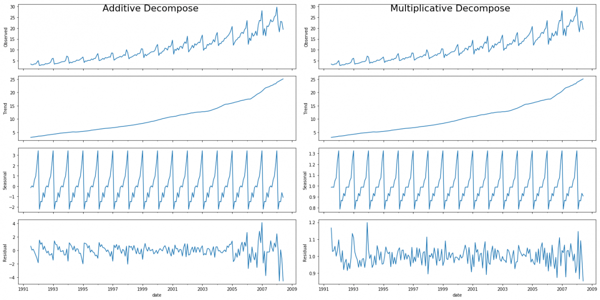
Components pattern of Times series

Slide 10
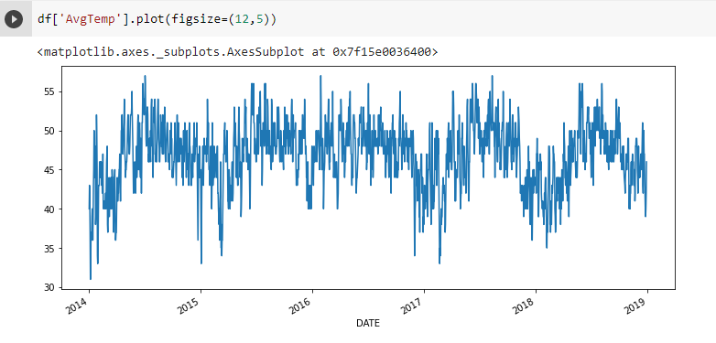
PLOT DATA

Slide 11
Data Processing
Missing Data Imputation
De-noising (Noise Reduction)
Feature Extraction :water content , solar radiation ,rainfall ,temperature ,RH,wind speed,wind direction
Dimensionality Reduction (PCA,VIF)
Feature Normalization and Standardization
Data Split
Data Augmentation (less used in time series task)
Regression Metrics: MAE (Mean Absolute Error), RMAE ,MSE (Mean Squared Error ), RMSE, ect
AR,ARIMA,ARIMAX,SARIMA,SARIMAX

Slide 12
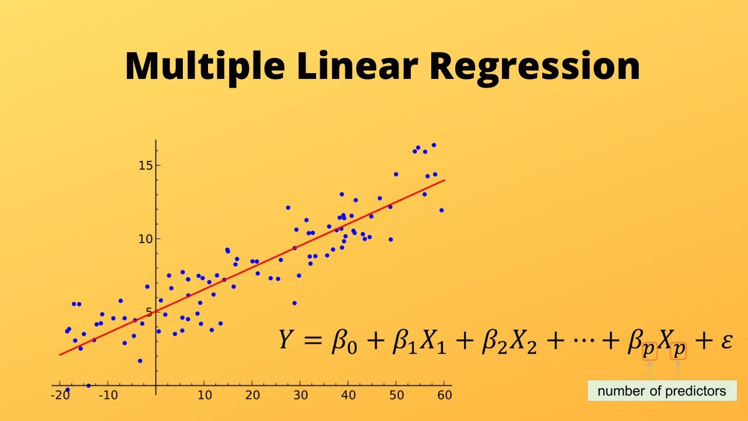
Machine Learning Algorithms
Formula and Calculation of Multiple Linear Regression
Equation: Y = β0 + β1X1 + β2X2 + β3X3 + … + βnXn + ε
Where
Y = Dependent variable / Target variable
β0 = Intercept of the regression line
β1, β2, β3, …. βn = Slope of the regression line which tells whether the line is increasing or decreasing
X1, X2, X3, ….Xn = Independent variable / Predictor variable
ε = Error
Machine learning algorithms are described as learning a target function (f) that best maps input variables (X) to an output variable (Y): Y = f(X).

Slide 13
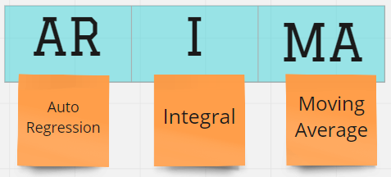
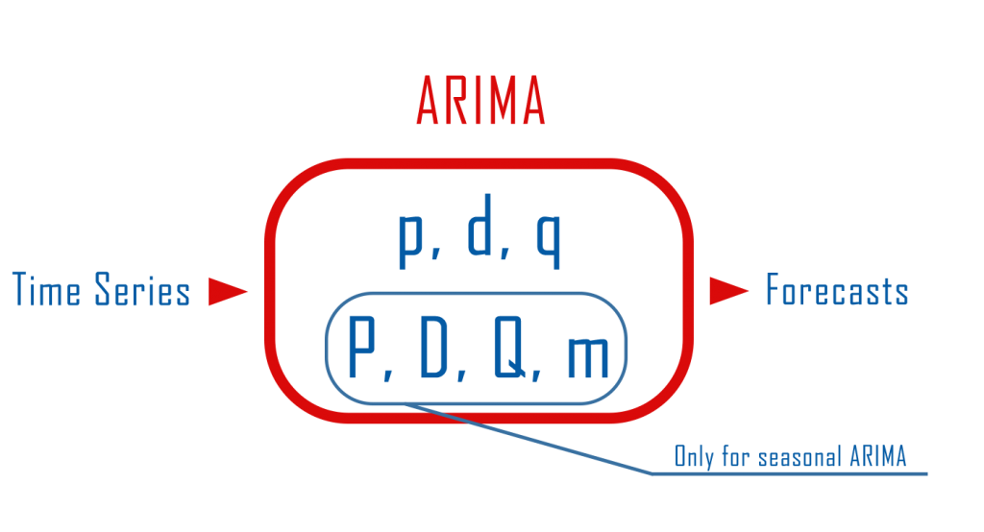
ARIMA MODEL

Slide 14
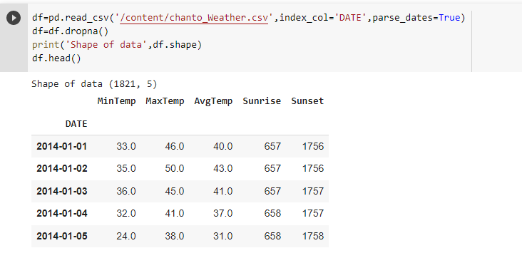
READ DATA

Slide 15
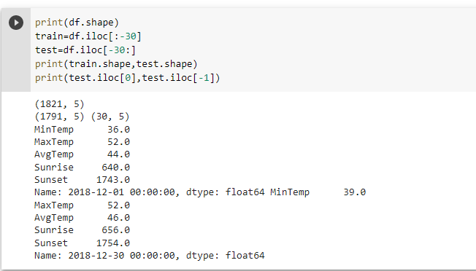
Training and Testing Data

Slide 16
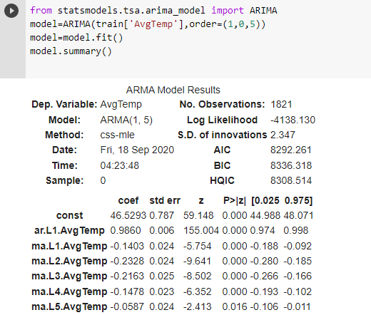
Train the Model

Slide 17
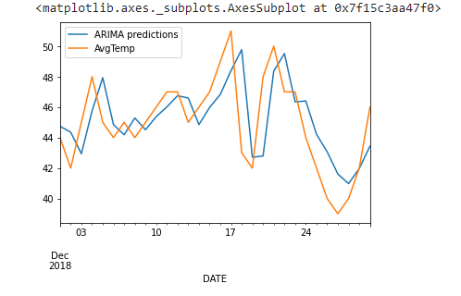
Make a prediction

Slide 18
Evaluation
MEAN : 45.0
RMSE: 2.3263

Slide 19
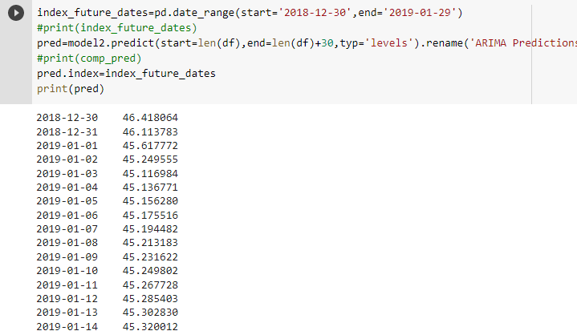
Future Date

Slide 20
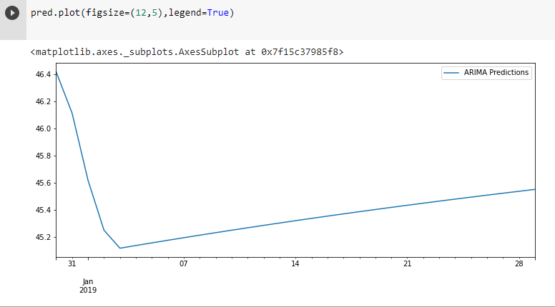
PLOT DATA

Slide 21
The advantage of Weather forecasting in agriculture
Help farmers better understand making an informed decision on
Crop Growth/Irrigation
Fertilizer Timing and Delivery
Pest and Disease Control
when to work efficiently in their day-to-day operation.
The Challenge of Weather forecasting in agriculture
It has many parameter
It difficult to forecast correctly
The weather forecasters get blamed if the weather is different from the forecast

Slide 22
References
WW2 Temperatures w/ Linear Regression
https://www.kaggle.com/code/caesarmario/ww2-temperatures-w-linear-regression/notebook
Time series: Delhi Weather Forecasting (ARIMA)
https://www.kaggle.com/code/amar09/time-series-delhi-weather-forecasting-arima/notebook
Intro to Time Series Forecasting
https://www.kaggle.com/code/iamleonie/intro-to-time-series-forecasting/notebook#Feature-Engineering
Summary of Weather_LinearRegression
https://www.kaggle.com/code/zahrahasanzadehh/summary-of-weather-linearregression/notebook
Weather Conditions in World War 2
https://www.kaggle.com/code/ronikdedhia/weather-conditions-in-world-war-2

Slide 23

Email: chanto.teng@cadt.edu.kh
Phone: 017 819 829

